Slide 1

You Only Look
YOLO 论文深度解读
· Training
· Predicting
· Non-max Suppression
· Darknet native on Windows

Slide 2
1.基本思路

Slide 3
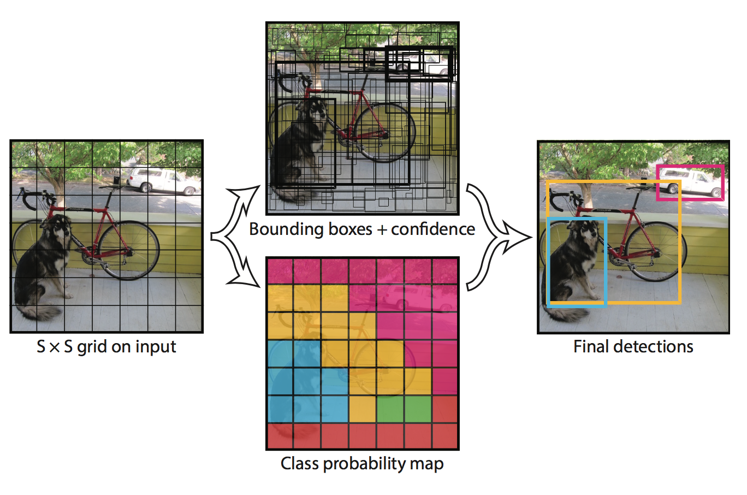
基本思路

Slide 4
2.Training

Slide 5
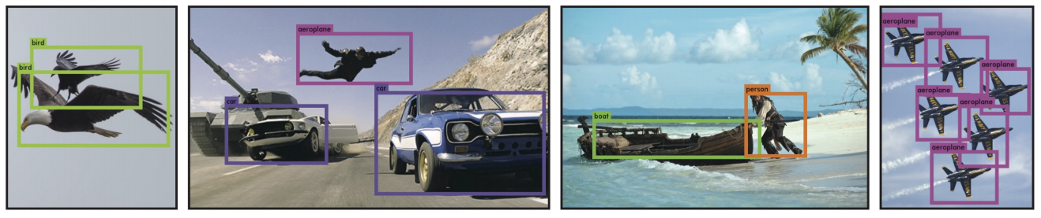
YOLO
You Only Look Once: Unified, Real-Time Object Detection
Joseph Redmon, Santosh Divvala, Ross Girshick, Ali Farhadi

Slide 6
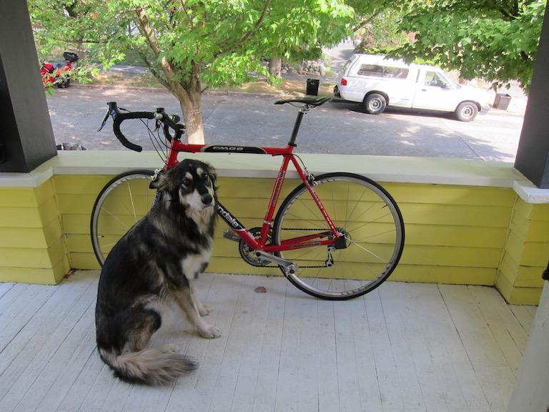
Inference
Input
image
GoogLeNet modification
(20 layers)
C,R
C,R
C,R
C,R
FC,R
FC
Reshape
7x7x1024
7x7x1024
7x7x30
14x14x1024
14x14x1024
14x14x1024
4096x1
1470x1
448x448x3

Slide 7
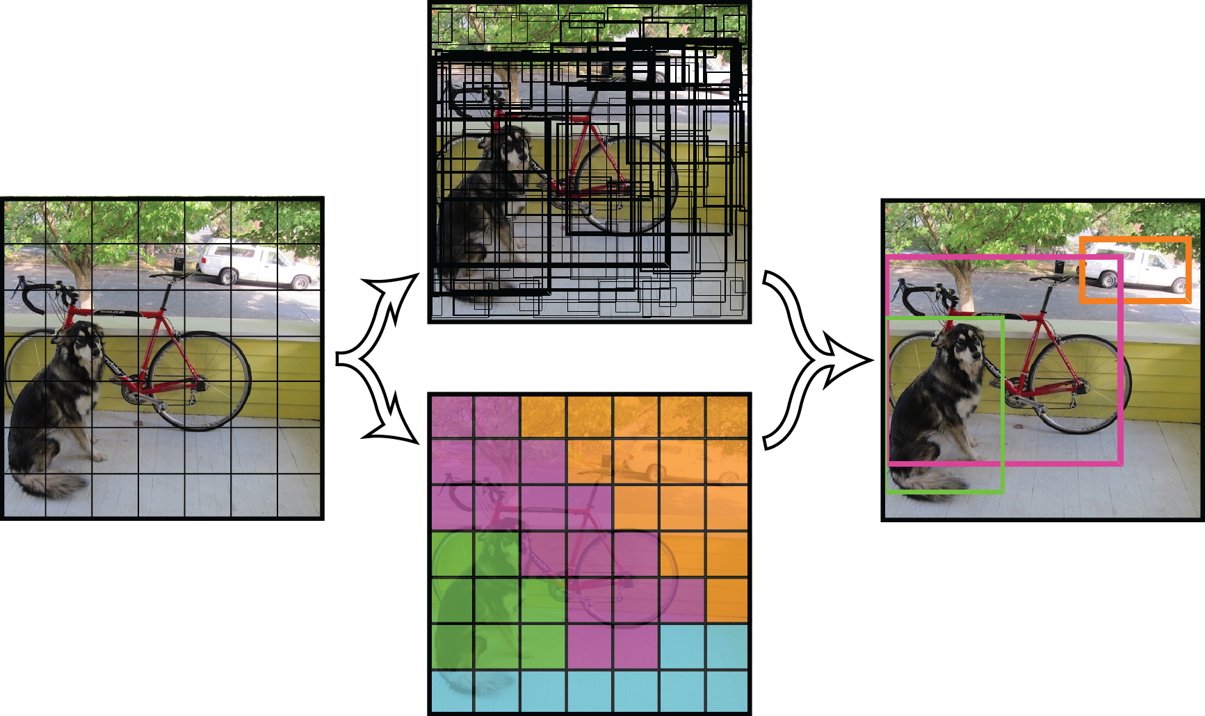
Inference
Input
image
GoogLeNet modification
(20 layers)
C,R
C,R
C,R
C,R
FC,R
FC
Reshape
7x7x1024
7x7x1024
7x7x30
14x14x1024
14x14x1024
14x14x1024
4096x1
1470x1
448x448x3
Detection Procedure

Slide 8
Inference
Input
image
GoogLeNet modification
(20 layers)
C,R
C,R
C,R
C,R
FC,R
FC
Reshape
7x7x1024
7x7x1024
7x7x30
14x14x1024
14x14x1024
14x14x1024
Train from scratch
4096x1
1470x1
448x448x3
Detection Procedure

Slide 9
Inference
use new additional conv layers => better performance
Input
image
GoogLeNet modification
(20 layers)
C,R
C,R
C,R
C,R
FC,R
FC
Reshape
7x7x1024
7x7x1024
7x7x30
14x14x1024
14x14x1024
14x14x1024
4096x1
1470x1
448x448x3
Detection Procedure

Slide 10
Inference
Input
image
Detection
Procedure
GoogLeNet modification
(20 layers)
C,R
C,R
C,R
C,R
FC,R
FC
Reshape
7x7x30
14x14x1024
14x14x1024
14x14x1024
7x7x1024
7x7x1024
4096x1
1470x1
448x448x3
Tensor values interpretation
7
7
30

Slide 11
Inference
Input
image
Detection
Procedure
GoogLeNet modification
(20 layers)
C,R
C,R
C,R
C,R
FC,R
FC
Reshape
7x7x30
14x14x1024
14x14x1024
14x14x1024
7x7x1024
7x7x1024
4096x1
1470x1
448x448x3
Tensor values interpretation
7
7
30

Slide 12
Inference
Input
image
Detection
Procedure
GoogLeNet modification
(20 layers)
C,R
C,R
C,R
C,R
FC,R
FC
Reshape
7x7x30
14x14x1024
14x14x1024
14x14x1024
7x7x1024
7x7x1024
4096x1
1470x1
448x448x3
Tensor values interpretation
7
7
30
7
grid cell
7

Slide 13
Inference
Input
image
Detection
Procedure
GoogLeNet modification
(20 layers)
C,R
C,R
C,R
C,R
FC,R
FC
Reshape
7x7x30
14x14x1024
14x14x1024
14x14x1024
7x7x1024
7x7x1024
4096x1
1470x1
448x448x3
Tensor values interpretation
7
7
30
7
grid cell
7

Slide 14
Inference
Input
image
Detection
Procedure
GoogLeNet modification
(20 layers)
C,R
C,R
C,R
C,R
FC,R
FC
Reshape
7x7x30
14x14x1024
14x14x1024
14x14x1024
7x7x1024
7x7x1024
4096x1
1470x1
448x448x3
Tensor values interpretation
1x30
7
7
30
7
grid cell
7

Slide 15
Inference
Input
image
Detection
Procedure
GoogLeNet modification
(20 layers)
C,R
C,R
C,R
C,R
FC,R
FC
Reshape
7x7x30
14x14x1024
14x14x1024
14x14x1024
7x7x1024
7x7x1024
4096x1
1470x1
448x448x3
Tensor values interpretation
1x30
5
7
x - coordinate of bbox center inside cell ([0; 1] wrt grid cell size)
y - coordinate of bbox center inside cell ([0; 1] wrt grid cell size)
w - bbox width ([0; 1] wrt image)
h - bbox height ([0; 1] wrt image)
c - bbox confidence ~ P(obj in bbox1)
7
30
7
grid cell
7

Slide 16
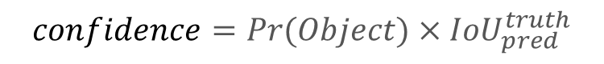
Inference
Input
image
Detection
Procedure
GoogLeNet modification
(20 layers)
C,R
C,R
C,R
C,R
FC,R
FC
Reshape
7x7x30
14x14x1024
14x14x1024
14x14x1024
7x7x1024
7x7x1024
4096x1
1470x1
448x448x3
Tensor values interpretation
1x30
5
5
7
x - coordinate of bbox center inside cell ([0; 1] wrt grid cell size)
y - coordinate of bbox center inside cell ([0; 1] wrt grid cell size)
w - bbox width ([0; 1] wrt image)
h - bbox height ([0; 1] wrt image)
c - bbox confidence
7
30
7
grid cell
$$confidence=Pr(Object)×{IoU}_{pred}^{truth}$$
7

Slide 17
Inference
Input
image
Detection
Procedure
GoogLeNet modification
(20 layers)
C,R
C,R
C,R
C,R
FC,R
FC
Reshape
7x7x30
14x14x1024
14x14x1024
14x14x1024
7x7x1024
7x7x1024
4096x1
1470x1
448x448x3
Tensor values interpretation
1x30
5
5
7
7
30
two bboxes for each grid cell
7
grid cell
7

Slide 18
Inference
Input
image
Detection
Procedure
GoogLeNet modification
(20 layers)
C,R
C,R
C,R
C,R
FC,R
FC
Reshape
7x7x30
14x14x1024
14x14x1024
14x14x1024
7x7x1024
7x7x1024
4096x1
1470x1
448x448x3
Tensor values interpretation
1x30
5
5
20 - number of classes
7
7
30
7
grid cell
7

Slide 19
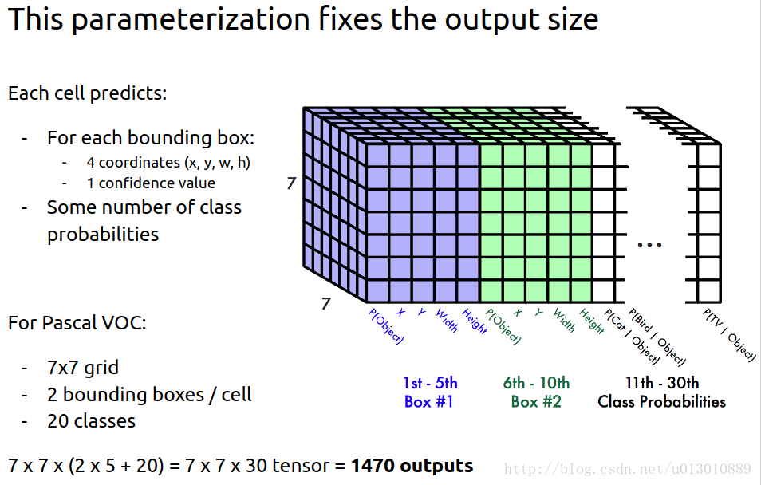

Slide 20
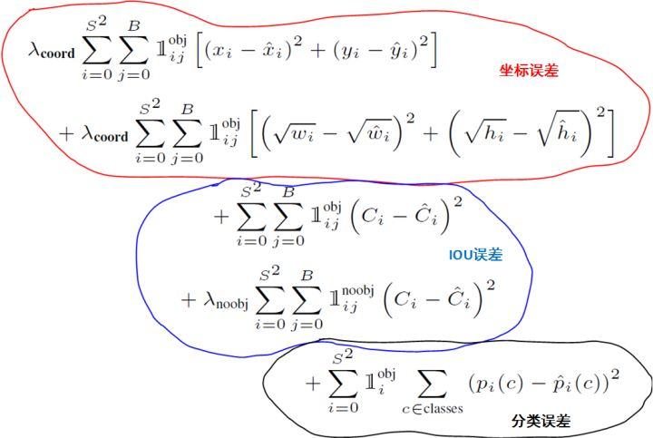
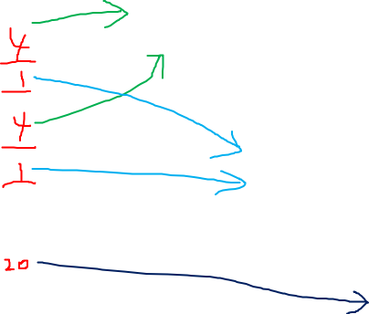
Loss
7
7

Slide 21
3.Testing

Slide 22
Non-max suppression
NMS
非极大值抑制

Slide 23
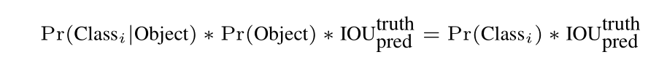
Inference
Input
image
Detection
Procedure
GoogLeNet modification
(20 layers)
C,R
C,R
C,R
C,R
FC,R
FC
Reshape
7x7x30
14x14x1024
14x14x1024
14x14x1024
7x7x1024
7x7x1024
4096x1
1470x1
448x448x3
Tensor values interpretation
bb1 confidence
1x30
5
5
20
MUL
7
7
30
7
grid cell
Class scores for bb1
7
20x1

Slide 24
Inference
Input
image
Detection
Procedure
GoogLeNet modification
(20 layers)
C,R
C,R
C,R
C,R
FC,R
FC
Reshape
7x7x30
14x14x1024
14x14x1024
14x14x1024
7x7x1024
7x7x1024
4096x1
1470x1
448x448x3
Tensor values interpretation
bb2 confidence
1x30
5
5
20
MUL
7
7
30
7
grid cell
Class scores for bb2
7
20x1

Slide 25
Inference
Input
image
Detection
Procedure
GoogLeNet modification
(20 layers)
C,R
C,R
C,R
C,R
FC,R
FC
Reshape
7x7x30
14x14x1024
14x14x1024
14x14x1024
7x7x1024
7x7x1024
4096x1
1470x1
448x448x3
Tensor values interpretation
bb2 confidence
1x30
5
5
20
MUL
7
Do this operation for each bbox in each grid cell
7
30
7
grid cell
Class scores for bb2
7
20x1

Slide 26
Inference
Input
image
Detection
Procedure
GoogLeNet modification
(20 layers)
C,R
C,R
C,R
C,R
FC,R
FC
Reshape
7x7x30
14x14x1024
14x14x1024
14x14x1024
7x7x1024
7x7x1024
4096x1
1470x1
448x448x3
Tensor values interpretation
2 bboxes for first cell (1, 1)
bb1
bb2
7
7
30
grid cell (1, 1)
7
7
20x1
20x1

Slide 27
Inference
Input
image
Detection
Procedure
GoogLeNet modification
(20 layers)
C,R
C,R
C,R
C,R
FC,R
FC
Reshape
7x7x30
14x14x1024
14x14x1024
14x14x1024
7x7x1024
7x7x1024
4096x1
1470x1
448x448x3
Tensor values interpretation
2 bboxes for second cell (1, 2)
bb1
bb2
bb4
bb3
7
7
30
grid cell (1, 2)
7
7
20x1
20x1
20x1
20x1

Slide 28
Inference
Input
image
Detection
Procedure
GoogLeNet modification
(20 layers)
C,R
C,R
C,R
C,R
FC,R
FC
Reshape
7x7x30
14x14x1024
14x14x1024
14x14x1024
7x7x1024
7x7x1024
4096x1
1470x1
448x448x3
Tensor values interpretation
2 bboxes for last cell (7, 7)
bb1
bb2
bb4
bb97
bb98
bb3
7
7
30
7
…….
grid cell (7, 7)
7
20x1
20x1
20x1
20x1
20x1
20x1
20x1
20x1
20x1
20x1
20x1
20x1
20x1
20x1
20x1

Slide 29
Inference
Input
image
Detection
Procedure
GoogLeNet modification
(20 layers)
C,R
C,R
C,R
C,R
FC,R
FC
Reshape
7x7x30
14x14x1024
14x14x1024
14x14x1024
7x7x1024
7x7x1024
4096x1
1470x1
448x448x3
Tensor values interpretation
Total 7*7*2 = 98 bboxes
bb1
bb2
bb4
bb97
bb98
bb3
7
7
30
7
…….
grid cell (7, 7)
7

Slide 30
Look at detection procedure
Detection
Procedure
7x7x30

Slide 31
bb1
bb2
bb3
bb98
bb4
bb97
…….
20x1
20x1
Class scores for each bbox

Slide 32
bb1
bb2
bb3
bb98
bb4
bb97
Dog scores
…….
20x1
20x1
Class scores for each bbox
Get first class scores for each bbox

Slide 33
bb1
bb2
bb3
bb98
bb4
bb97
bb1
bb2
bb3
bb98
bb4
bb97
Dog scores
0
0
0
Set zero
if score < thresh1 (0.2)
…….
…….
20x1
20x1

Slide 34
bb98
bb1
bb2
bb98
bb1
bb2
bb3
bb3
bb98
bb4
bb97
bb1
bb2
bb3
bb98
bb4
bb4
bb97
Dog scores
0
0
0
0
0
0
Set zero
if score < thresh1 (0.2)
Sort descending
…….
…….
…….
20x1
20x1

Slide 35
bb98
bb1
bb2
bb98
bb1
bb2
bb3
bb3
bb98
bb4
bb97
bb1
bb2
bb3
bb98
bb4
bb4
bb97
bb1
bb2
bb98
bb3
bb98
bb4
Dog scores
0
0
0
0
0
0
0
0
0
0
Set zero
if score < thresh1 (0.2)
NMS algorithm set
scores to zero for redundant bboxes
Sort descending
…….
…….
…….
…….
20x1
20x1

Slide 36
bb98
bb1
bb2
bb98
bb1
bb2
bb3
bb3
bb98
bb4
bb97
bb1
bb2
bb3
bb98
bb4
bb4
bb97
bb1
bb2
bb98
bb3
bb98
bb4
Dog scores
0
0
0
0
0
0
0
0
0
0
Set zero
if score < thresh1 (0.2)
NMS algorithm set
scores to zero for redundant bboxes
Sort descending
…….
…….
…….
…….
20x1
20x1
How it works

Slide 37
Non-Maximum Suppression: intuition

Slide 38
Non-Maximum Suppression: intuition
class (dog) scores for each bbox
bb47
bb20
bb15
bb7
bb1
bb4
bb8
bb98
class: dog
1x98
0.8
0.5
0.3
0.2
0
0
0
0

Slide 39
Non-Maximum Suppression: intuition
bb47
bb20
bb15
bb7
bb1
bb4
bb8
bb98
class: dog
1x98
0.8
0.5
0.3
0.2
0
0
0
0

Slide 40
Non-Maximum Suppression: intuition
bb47
bb20
bb15
bb7
bb1
bb4
bb8
bb98
class: dog
1x98
0.8
0.5
0.3
0.2
0
0
0
0

Slide 41
Non-Maximum Suppression: intuition
bb47
bb20
bb15
bb7
bb1
bb4
bb8
bb98
class: dog
1x98
0.8
0.5
0.3
0.2
0
0
0
0

Slide 42
Non-Maximum Suppression: intuition
bb47
bb20
bb15
bb7
bb1
bb4
bb8
bb98
class: dog
1x98
0.8
0.5
0.3
0.2
0
0
0
0

Slide 43
Non-Maximum Suppression: intuition
bb47
bb20
bb15
bb7
bb1
bb4
bb8
bb98
class: dog
1x98
0.8
0.5
0.3
0.2
0
0
0
0

Slide 44
Non-Maximum Suppression: intuition
bb47
bb20
bb15
bb7
bb1
bb4
bb8
bb98
class: dog
1x98
0.8
0.5
0.3
0.2
0
0
0
0
Get bbox with max score. Let’s denote it “bbox_max”

Slide 45
Non-Maximum Suppression: intuition
bb47
bb20
bb15
bb7
bb1
bb4
bb8
bb98
class: dog
1x98
0.8
0.5
0.3
0.2
0
0
0
0
Compare “bbox_max” with others less score (non-zero!) bboxes. Let’s denote it “bbox_cur”

Slide 46
Non-Maximum Suppression: intuition
bb47
bb20
bb15
bb7
bb1
bb4
bb8
bb98
class: dog
1x98
0.8
0.5
0.3
0.2
0
0
0
0
If IoU(bbox_max, bbox_cur) > 0.5 then set 0 score to bbox_cur.

Slide 47
Non-Maximum Suppression: intuition
bb47
bb20
bb15
bb7
bb1
bb4
bb8
bb98
class: dog
0.8
1x98
0
0.3
0.2
0
0
0
0
If IoU(bbox_max, bbox_cur) > 0.5 then set 0 score to bbox_cur.
In this case: set to 0.

Slide 48
Non-Maximum Suppression: intuition
bb47
bb20
bb15
bb7
bb1
bb4
bb8
bb98
class: dog
0.8
1x98
0
0.3
0.2
0
0
0
0
Go to next bbox_cur.

Slide 49
Non-Maximum Suppression: intuition
bb47
bb20
bb15
bb7
bb1
bb4
bb8
bb98
class: dog
0.8
1x98
0
0.3
0.2
0
0
0
0
Go to next bbox_cur.
If IoU(bbox_max, bbox_cur) > 0.5 then set 0 score to bbox_cur.

Slide 50
Non-Maximum Suppression: intuition
bb47
bb20
bb15
bb7
bb1
bb4
bb8
bb98
class: dog
0.8
1x98
0
0.3
0.2
0
0
0
0
Go to next bbox_cur.
If IoU(bbox_max, bbox_cur) > 0.5 then set 0 score to bbox_cur.
In this case: continue.

Slide 51
Non-Maximum Suppression: intuition
bb47
bb20
bb15
bb7
bb1
bb4
bb8
bb98
class: dog
0.8
1x98
0
0.3
0.2
0
0
0
0
Go to next bbox_cur.

Slide 52
Non-Maximum Suppression: intuition
bb47
bb20
bb15
bb7
bb1
bb4
bb8
bb98
class: dog
0.8
1x98
0
0.3
0.2
0
0
0
0
Go to next bbox_cur.
If IoU(bbox_max, bbox_cur) > 0.5 then set 0 score to bbox_cur.

Slide 53
Non-Maximum Suppression: intuition
bb47
bb20
bb15
bb7
bb1
bb4
bb8
bb98
class: dog
0.8
1x98
0
0.3
0.2
0
0
0
0
Go to next bbox_cur.
If IoU(bbox_max, bbox_cur) > 0.5 then set 0 score to bbox_cur.
In this case: continue.

Slide 54
Non-Maximum Suppression: intuition
bb47
bb20
bb15
bb7
bb1
bb4
bb8
bb98
class: dog
1x98
0.8
1x98
0
0.3
0.2
0
0
0
0
Go to next bbox_cur.
If IoU(bbox_max, bbox_cur) > 0.5 then set 0 score to bbox_cur.
In this case: continue.
Do this procedure for other “bbox_cur”. After that ...

Slide 55
Non-Maximum Suppression: intuition
bb47
bb20
bb15
bb7
bb1
bb4
bb8
bb98
class: dog
1x98
0.8
1x98
0
0.3
0.2
0
0
0
0
Go to next bbox with big score. Let’s denote it “bbox_max”

Slide 56
Non-Maximum Suppression: intuition
bb47
bb20
bb15
bb7
bb1
bb4
bb8
bb98
class: dog
0.8
1x98
0
0.3
0.2
0
0
0
0
Go to next bbox_cur.

Slide 57
Non-Maximum Suppression: intuition
bb47
bb20
bb15
bb7
bb1
bb4
bb8
bb98
class: dog
0.8
1x98
0
0.3
0.2
0
0
0
0
Go to next bbox_cur.
If IoU(bbox_max, bbox_cur) > 0.5 then set 0 score to bbox_cur.

Slide 58
Non-Maximum Suppression: intuition
bb47
bb20
bb15
bb7
bb1
bb4
bb8
bb98
class: dog
1x98
0.8
1x98
0
0.3
0
0
0
0
0
Go to next bbox_cur.
If IoU(bbox_max, bbox_cur) > 0.5 then set 0 score to bbox_cur.
In this case: set to 0.
Do this procedure for other “bbox_max” and for other corresponding “bbox_cur”.

Slide 59
Non-Maximum Suppression: intuition
bb47
bb20
bb15
bb7
bb1
bb4
bb8
bb98
class: dog
0.8
0
0.3
0
0
0
0
0
After comparison almost all pairs of bboxes the only two bboxes left with non-zero class score value.

Slide 60
bb98
bb1
bb2
bb98
bb1
bb2
bb3
bb3
bb98
bb4
bb97
bb1
bb2
bb3
bb98
bb4
bb4
bb97
bb1
bb2
bb98
bb3
bb98
bb4
Cat scores
0
0
0
0
0
0
0
0
0
0
Set zero
if score < thresh1 (0.2)
NMS algorithm set
scores to zero for redundant bboxes
Sort descending
…….
…….
…….
…….
20x1
20x1
Do this procedure for next class

Slide 61
bb98
bb1
bb2
bb98
bb1
bb2
bb3
bb3
bb98
bb4
bb97
bb1
bb2
bb3
bb98
bb4
bb4
bb97
bb1
bb2
bb98
bb3
bb98
bb4
Set zero
if score < thresh1 (0.2)
NMS algorithm set
scores to zero for redundant bboxes
Sort descending
…….
…….
…….
…….
person scores
0
0
0
0
0
0
0
0
0
0
20x1
20x1
Do this procedure for all classes

Slide 62
bb98
bb1
bb2
bb98
bb1
bb2
bb3
bb3
bb98
bb4
bb97
bb1
bb2
bb3
bb98
bb4
bb4
bb97
bb1
bb2
bb98
bb3
bb98
bb4
0
0
0
Set zero
if score < thresh1 (0.2)
NMS algorithm set
scores to zero for redundant bboxes
Sort descending
0
…….
…….
…….
…….
0
0
person scores
0
0
0
0
0
0
0
0
0
0
20x1
20x1
After this procedure -
a lot of zeros

Slide 63
bb98
bb1
bb2
bb98
bb1
bb2
bb3
bb3
bb98
bb4
bb97
bb1
bb2
bb3
bb98
bb4
bb4
bb97
bb1
bb2
bb98
bb3
bb98
bb4
0
0
0
Set zero
if score < thresh1 (0.2)
NMS algorithm set
scores to zero for redundant bboxes
Sort descending
0
…….
…….
…….
…….
0
0
person scores
0
0
0
0
0
0
0
0
0
0
20x1
20x1
Select bboxes to draw by class score values

Slide 64


bb98
bb1
bb2
bb97
bb1
bb2
bb3
bb3
bb98
bb4
bb97
bb1
bb2
bb3
bb98
bb4
bb4
bb97
bb1
bb2
bb97
bb3
bb98
bb4
0
0
0
Set zero
if score < thresh1 (0.2)
NMS algorithm set
scores to zero for redundant bboxes
Sort descending
0
…….
…….
…….
…….
0
0
0
0
0
0
0
0
0
0
0
0
20x1
20x1
class = max_index(scores for bb3);
score = max(scores for bb3);
skip bbox
no
Score > 0
yes
draw bbox with class color

Slide 65
bb98
bb1
bb2
bb97
bb1
bb2
bb3
bb3
bb98
bb4
bb97
bb1
bb2
bb3
bb98
bb4
bb4
bb97
bb1
bb2
bb97
bb3
bb98
bb4
0
0
0
Set zero
if score < thresh1 (0.2)
NMS algorithm set
scores to zero for redundant bboxes
Sort descending
0
…….
…….
…….
…….
0
0
0
0
0
0
0
0
0
0
0
0
20x1
20x1
class = max_index(scores for bb1);
score = max(scores for bb1);
skip bbox
no
Score > 0
yes
draw bbox with class color

Slide 66
bb98
bb1
bb2
bb97
bb1
bb2
bb3
bb3
bb98
bb4
bb97
bb1
bb2
bb3
bb98
bb4
bb4
bb97
bb1
bb2
bb97
bb3
bb98
bb4
0
0
0
Set zero
if score < thresh1 (0.2)
NMS algorithm set
scores to zero for redundant bboxes
Sort descending
0
…….
…….
…….
…….
0
0
0
0
0
0
0
0
0
0
0
0
20x1
20x1
class = max_index(scores for bb98);
score = max(scores for bb98);
skip bbox
no
Score > 0
yes
draw bbox with class color

Slide 67
bb98
bb1
bb2
bb97
bb1
bb2
bb3
bb3
bb98
bb4
bb97
bb1
bb2
bb3
bb98
bb4
bb4
bb97
bb1
bb2
bb97
bb3
bb98
bb4
0
0
0
Set zero
if score < thresh1 (0.2)
NMS algorithm set
scores to zero for redundant bboxes
Sort descending
0
…….
…….
…….
…….
0
0
0
0
0
0
0
0
0
0
0
0
20x1
20x1
class = max_index(scores for bb97);
score = max(scores for bb97);
skip bbox
no
Score > 0
yes
draw bbox with class color

Slide 68
bb98
bb1
bb2
bb97
bb1
bb2
bb3
bb3
bb98
bb4
bb97
bb1
bb2
bb3
bb98
bb4
bb4
bb97
bb1
bb2
bb97
bb3
bb98
bb4
Set zero
if score < thresh1 (0.2)
NMS algorithm set
scores to zero for redundant bboxes
Sort descending
…….
…….
…….
…….
0
0
0
0
0
0
0
0
0
0
20x1
20x1

Slide 69
4.YOLO_V3

Slide 70
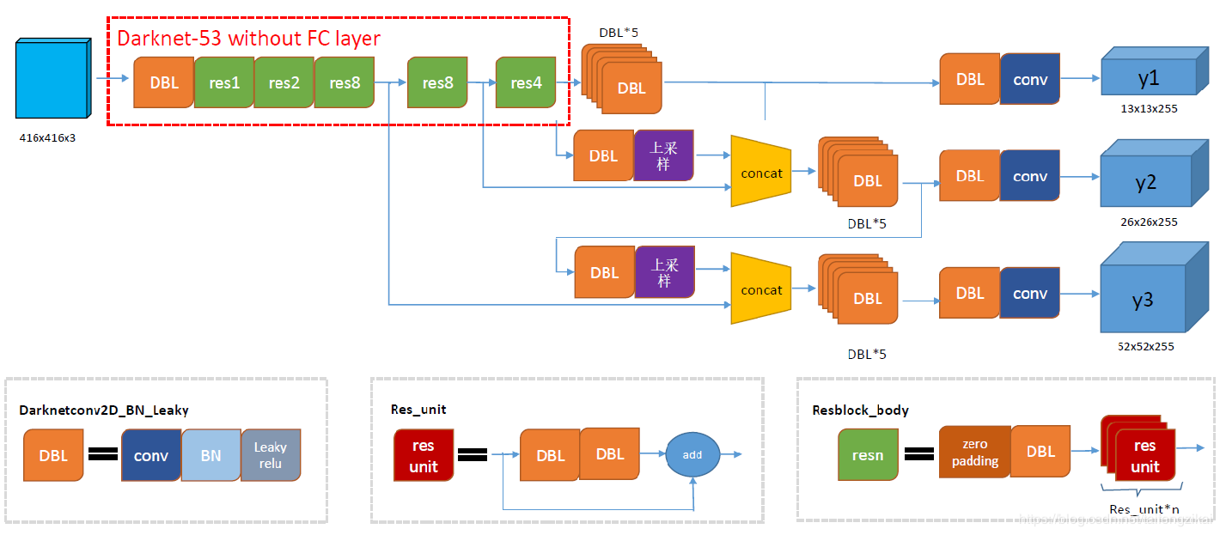
YOLO_V3 网络架构

Slide 71
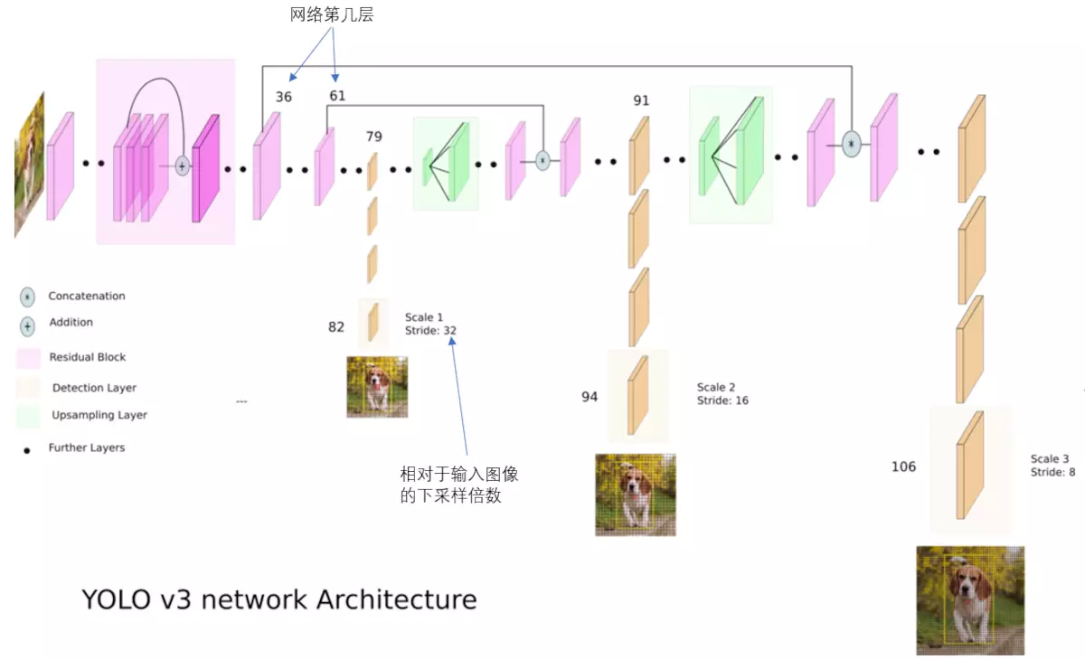
Notes:
结合上图看，卷积网络在79层后，经过下方几个黄色的卷积层得到一种尺度的检测结果。相比输入图像，这里用于检测的特征图有32倍的下采样。比如输入是416*416的话，这里的特征图就是13*13了。由于下采样倍数高，这里特征图的感受野比较大，因此适合检测图像中尺寸比较大的对象。
为了实现细粒度的检测，第79层的特征图又开始作上采样（从79层往右开始上采样卷积），然后与第61层特征图融合（Concatenation），这样得到第91层较细粒度的特征图，同样经过几个卷积层后得到相对输入图像16倍下采样的特征图。它具有中等尺度的感受野，适合检测中等尺度的对象。
最后，第91层特征图再次上采样，并与第36层特征图融合（Concatenation），最后得到相对输入图像8倍下采样的特征图。它的感受野最小，适合检测小尺寸的对象。

Slide 72
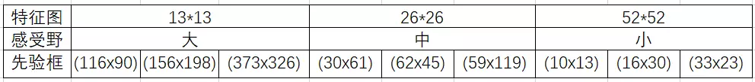
先验检测框
Notes:
分配上，在最小的13*13特征图上（有最大的感受野）应用较大的先验框(116x90)，(156x198)，(373x326)，适合检测较大的对象。中等的26*26特征图上（中等感受野）应用中等的先验框(30x61)，(62x45)，(59x119)，适合检测中等大小的对象。较大的52*52特征图上（较小的感受野）应用较小的先验框(10x13)，(16x30)，(33x23)，适合检测较小的对象。

Slide 73
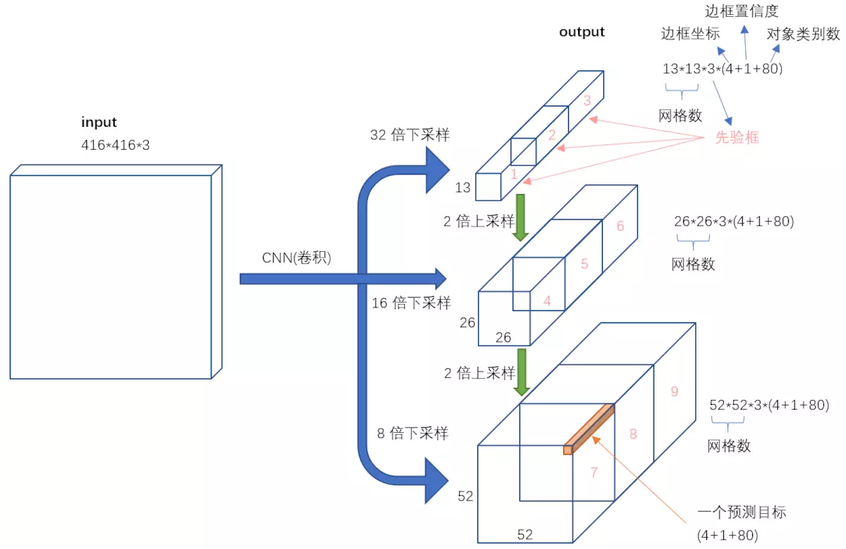
输入映射到输出
Notes:
我们看一下YOLO3共进行了多少个预测。对于一个416*416的输入图像，在每个尺度的特征图的每个网格设置3个先验框，总共有 13*13*3 + 26*26*3 + 52*52*3 = 10647 个预测。每一个预测是一个(4+1+80)=85维向量，这个85维向量包含边框坐标（4个数值），边框置信度（1个数值），对象类别的概率（对于COCO数据集，有80种对象）。
对比一下，YOLO2采用13*13*5 = 845个预测，YOLO3的尝试预测边框数量增加了10多倍，而且是在不同分辨率上进行，所以mAP以及对小物体的检测效果有一定的提升。

Slide 74
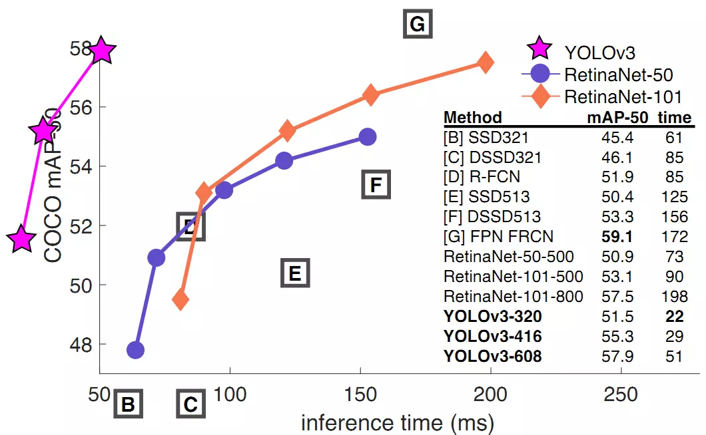
YOLO_V3小结
Notes:
YOLO3借鉴了残差网络结构，形成更深的网络层次，以及多尺度检测，提升了mAP及小物体检测效果。如果采用COCO mAP50做评估指标（不是太介意预测框的准确性的话），YOLO3的表现相当惊人，如下图所示，在精确度相当的情况下，YOLOv3的速度是其它模型的3、4倍。

Slide 75
5. 程序演示

